Slide 1
Lecture 16: Nuclear Imaging: System & Applications
Dr. Guohua Cao （曹国华） caogh@shanghaitech.edu.cn
School of Biomedical Engineering
ShanghaiTech University
4/2/2023

Slide 2
Signal-to-Noise Ratio
Dominate source of image noise is due to relatively limited number of total γ-ray events
Counts in each image histogram bin are Poisson distributed
Total number of counts (N) is ~1.0e6
SNR Due to Poisson Counting Statistics Alone
_{SNR =} E[N ] N
=
= N
σ _{N}
N
Total counts depends on activity of radiotracer, sensitivity of gamma camera, acquisition time, and tissue attenuation

Slide 3
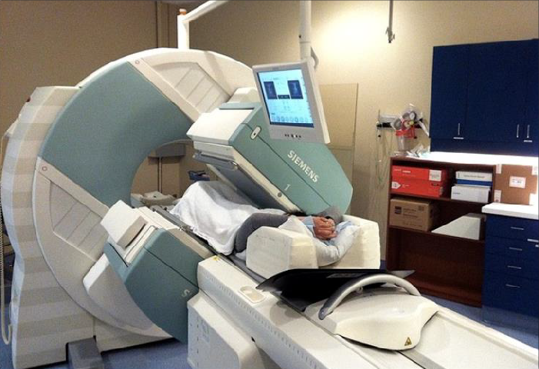

SPECT Overview
One or more gamma cameras are rotated around the subject during data acquisition
Estimates of the 3D tracer distribution are computed with tomographic reconstruction algorithms

Slide 4


SPECT Acquisition
Just as for X-ray CT, detectors are rotated around the subject, to acquire fully tomographic data sets
Circular Orbit Sinogram
Contoured Orbit
Detectors must be rotated >= 180 deg
Due to close proximity to subject and large mass of detectors rotation time is ~ couple of minutes

Slide 5
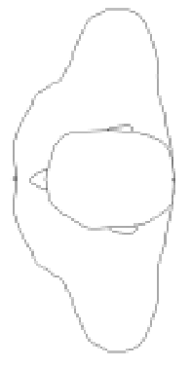
Gamma Camera Configurations
Single Headed Triple Headed
Double Headed
Different clinical applications utilize specific detector configurations
Increasing the number of gamma cameras and closeness to subject leads to increase in image SNR!

Slide 6
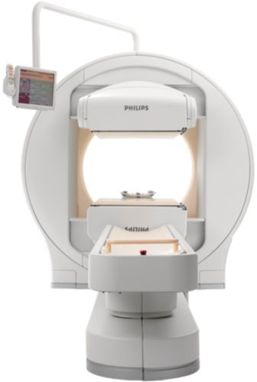
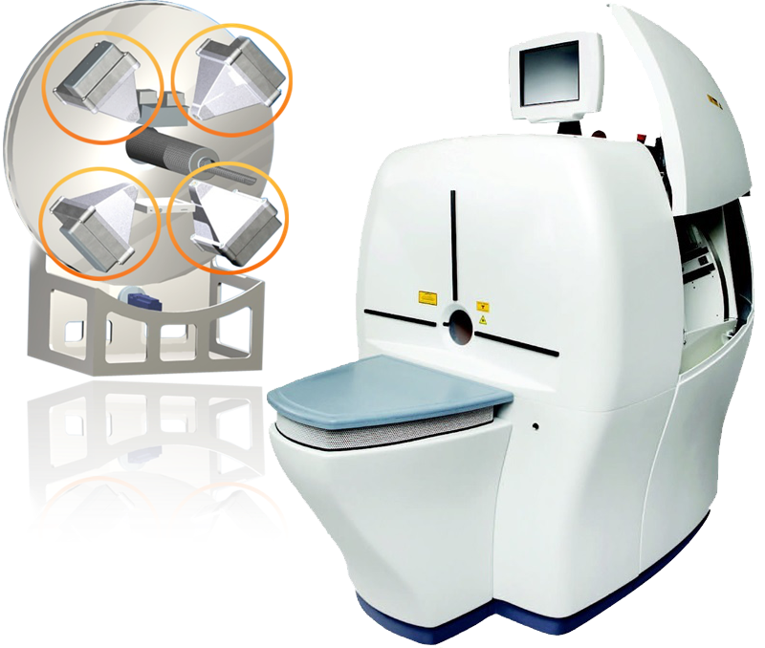
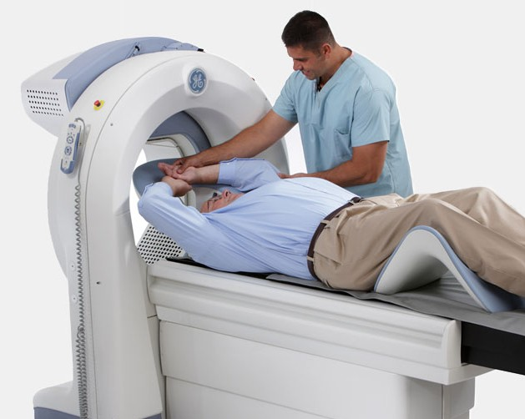
SPECT Scanners
Multi-purpose System
Small Animal Scanner
Dedicated Cardiac System

Slide 7


Image Reconstruction
Subject Compton Scatter
y ≈ Poisson(PAx + s)
Data
System Matrix
Subject Attenuation
Activity Distribution
Images are quantitative if subject attenuation and scatter are corrected for!

Slide 8
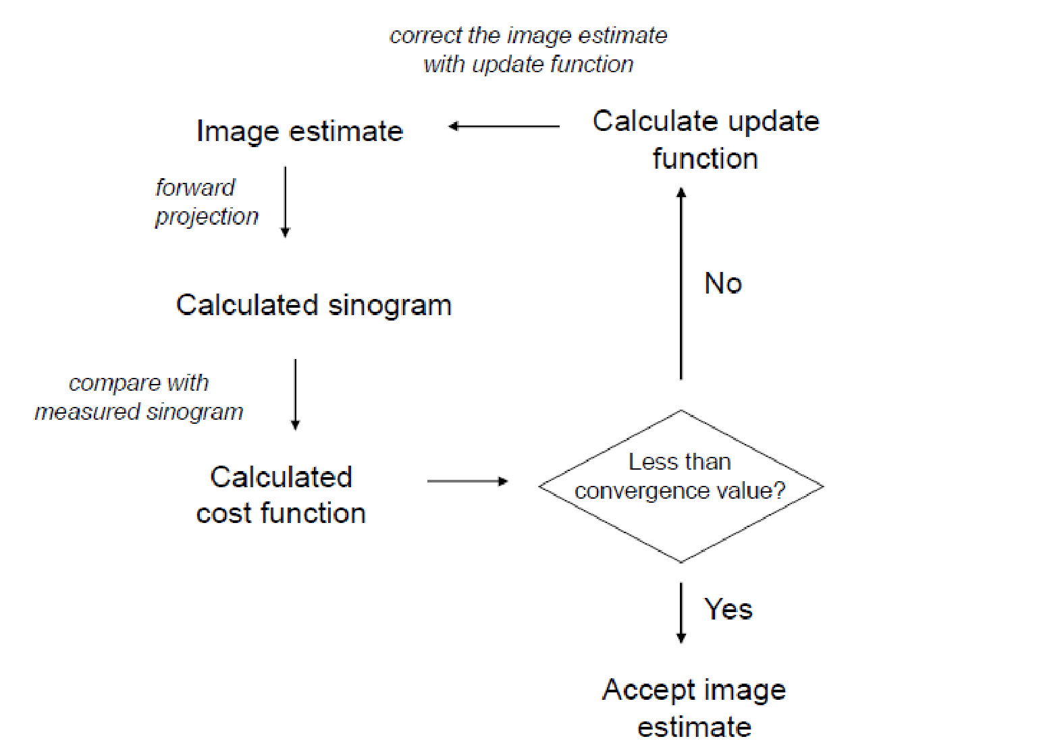
Iterative Image Reconstruction

Slide 9
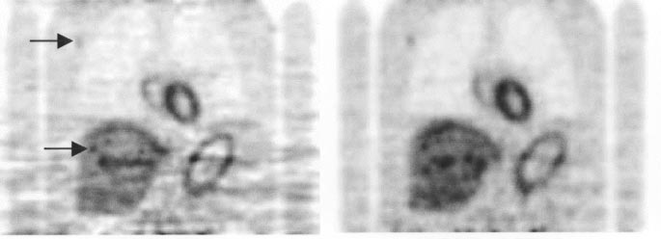
Linear versus Iterative Reconstruction
Iterative reconstruction algorithms give superior image quality over linear methods for nuclear imaging
Filtered Backprojection (FBP) Iterative
Comparison of Iterative and FBP Reconstructions
Iterative has significantly higher SNR, especially for limited count acquisitions
Iterative is much less prone to artifacts, due to incorporation of system response
Iterative is much more computationally complex due to multiple forward and back-projection operations
FBP is a linear algorithm, while iterative methods are non-linear

Slide 10
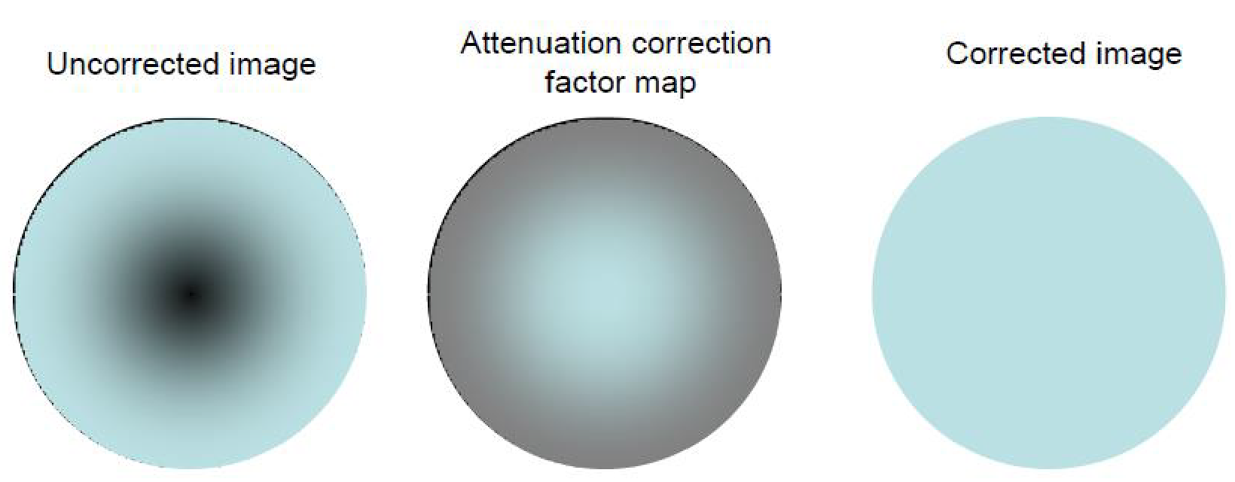
Attenuation Correction
Uncorrected attenuation leads to an underestimation of tracer uptake in reconstructed images
Challenging since attenuation is depth dependent

Slide 11
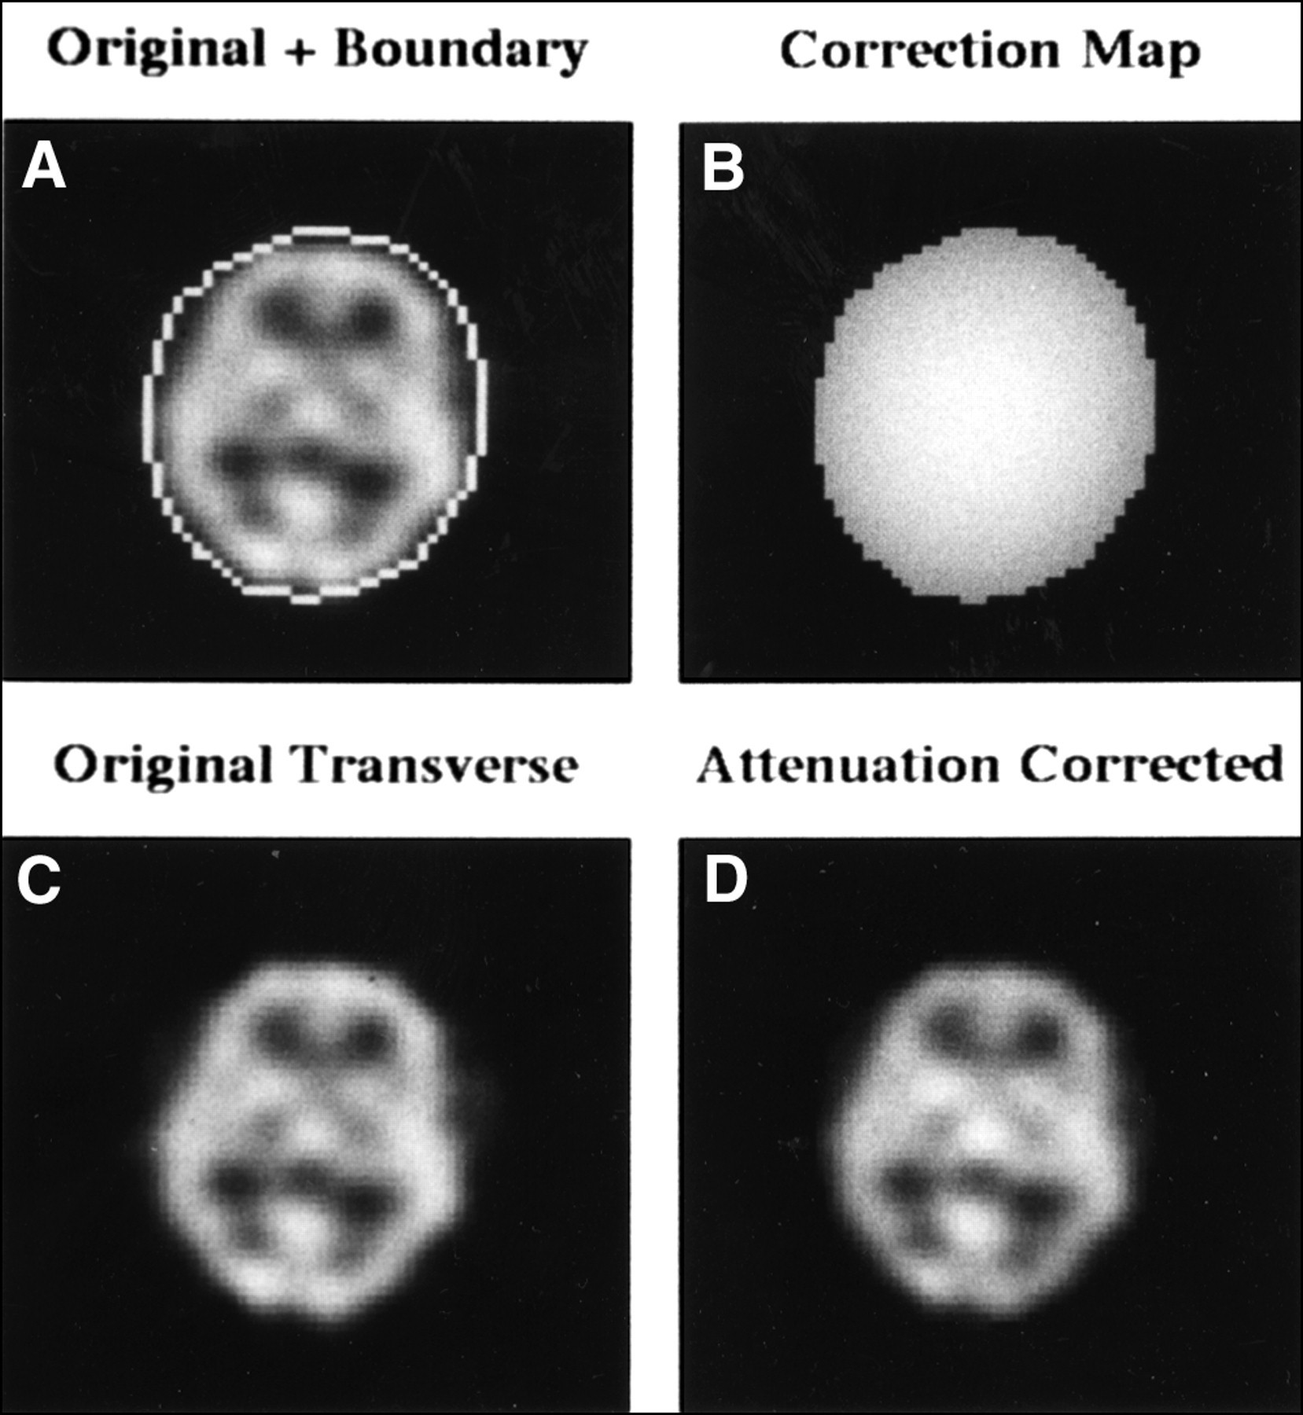
Attenuation Correction Methods
Chang’s Multiplicative Method

Slide 12
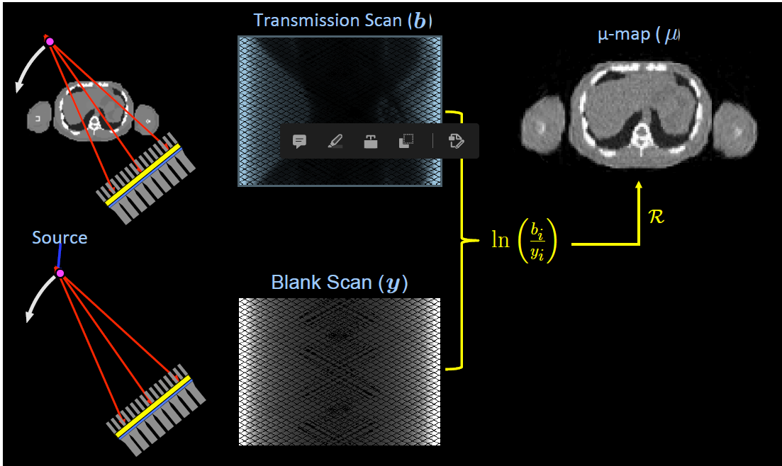
Measured Attenuation Correction

Slide 13
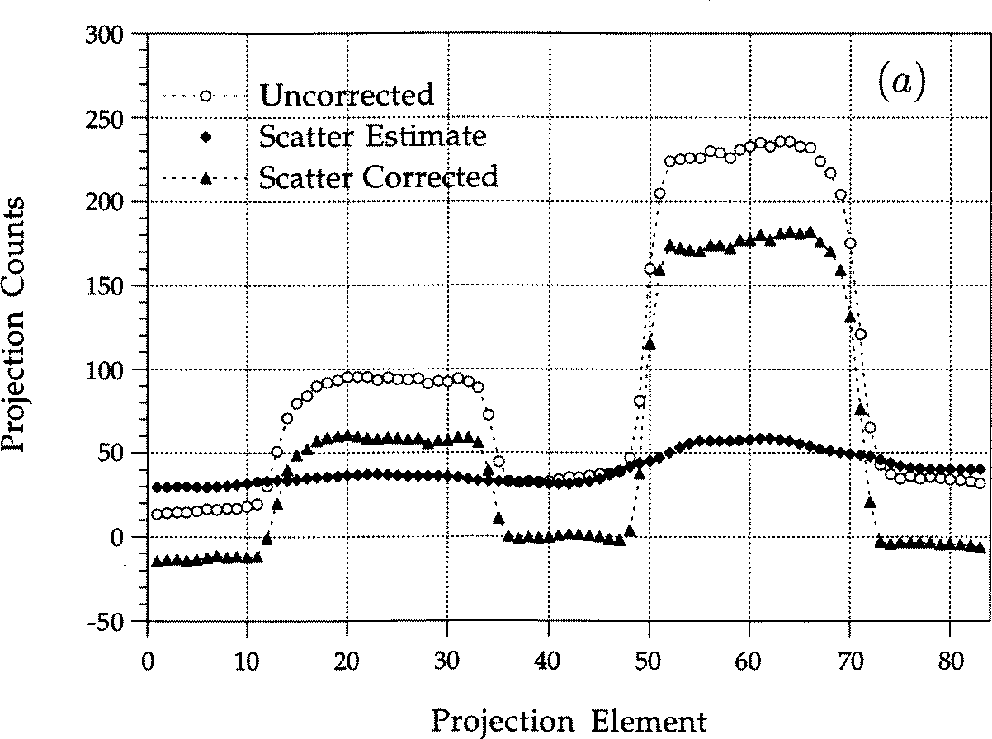
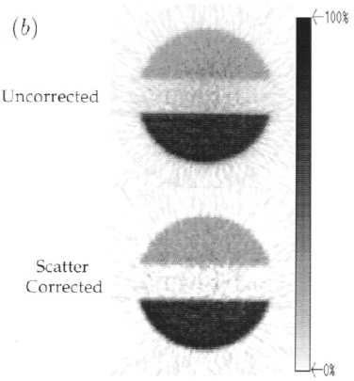
Scatter Correction
Scatter causes a low spatial frequency offset to SPECT images if not corrected for

Slide 14
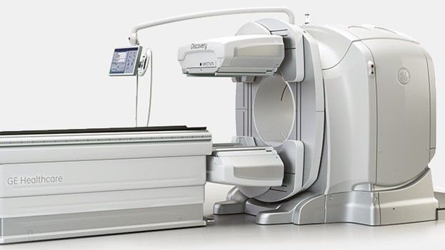
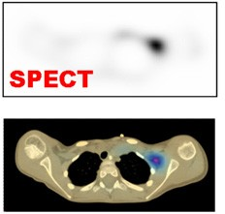
SPECT-CT Scanners
Allows localization of tracer distribution wrt anatomy
CT images can be used to estimate attenuation at γ- ray energy

Slide 15
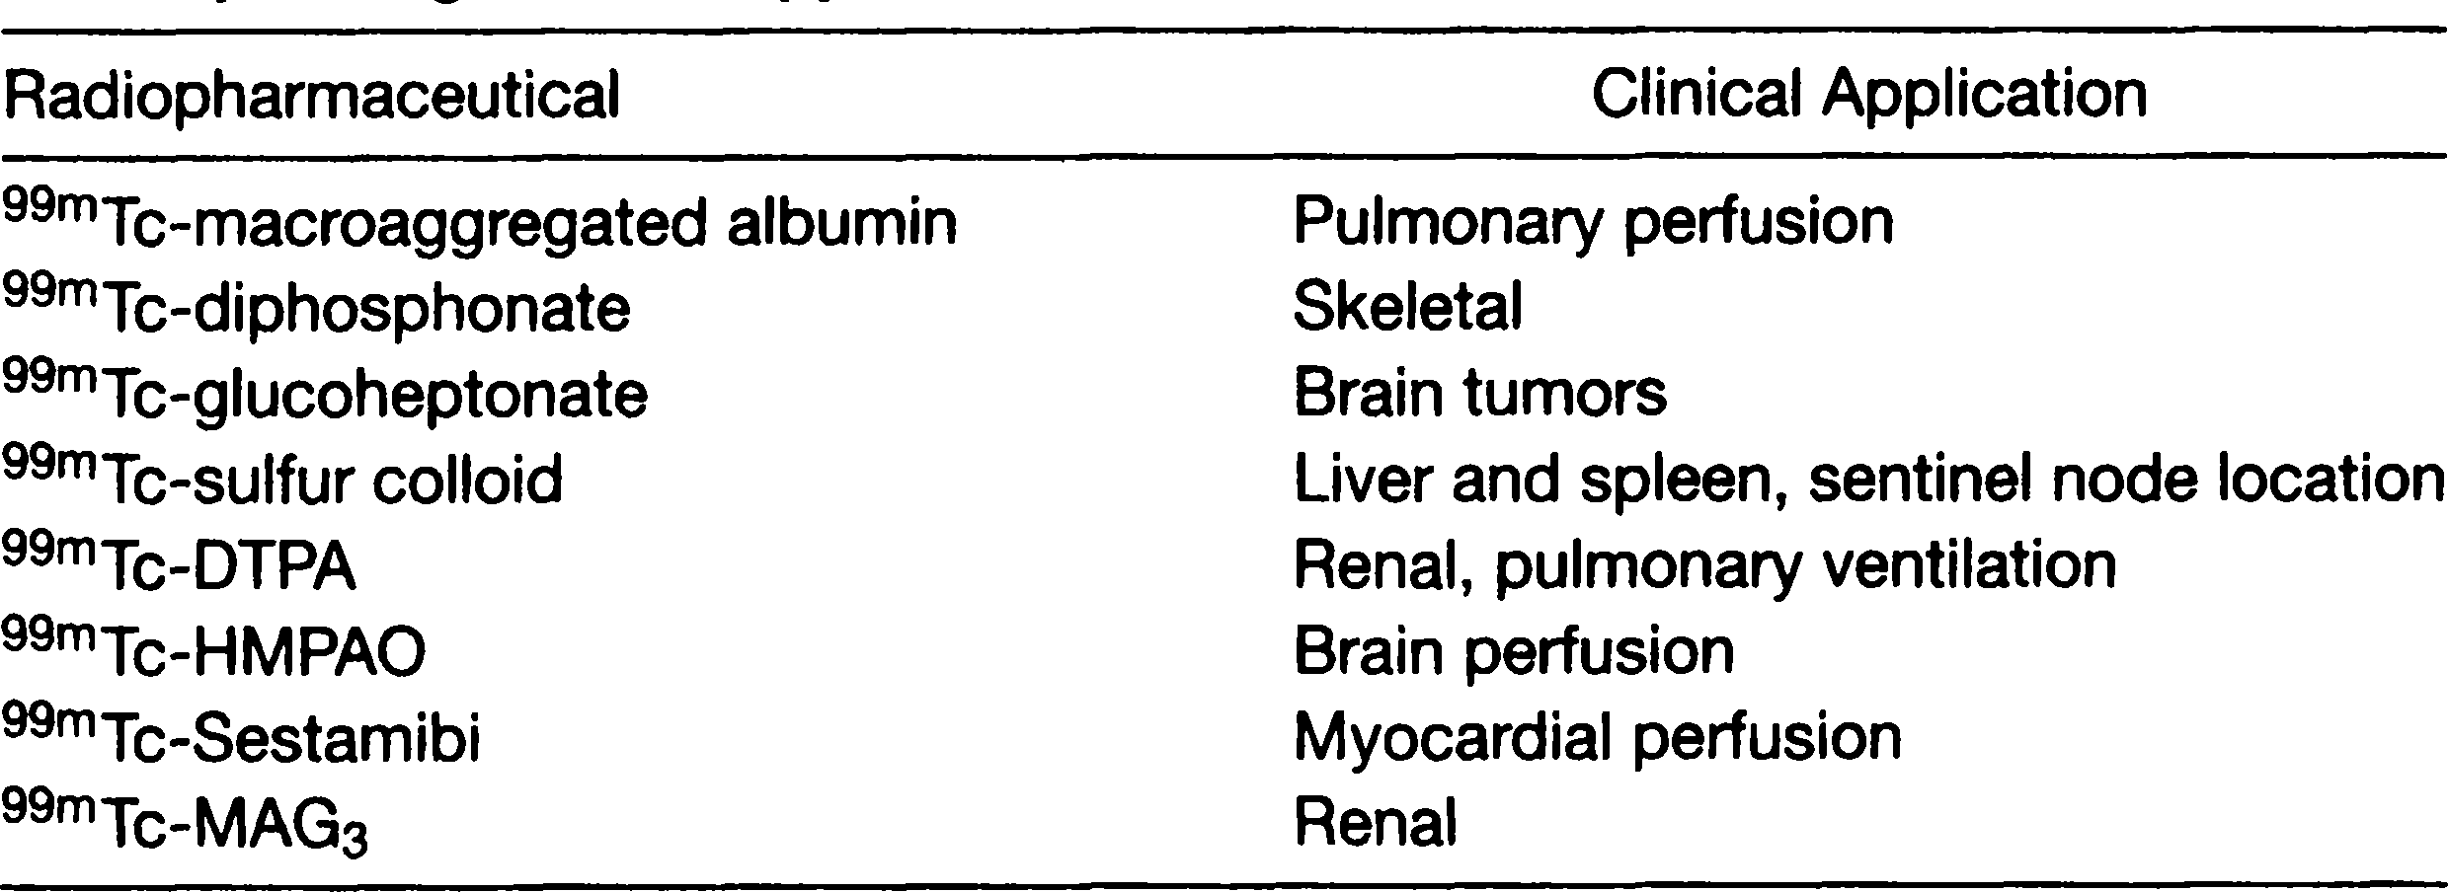
SPECT Radiotracers
Most frequently ^{99m}Tc labeled radiotracers

Slide 16
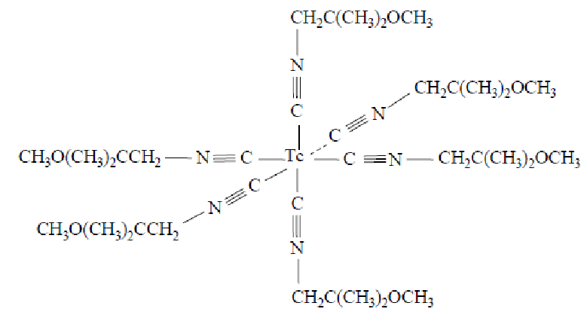
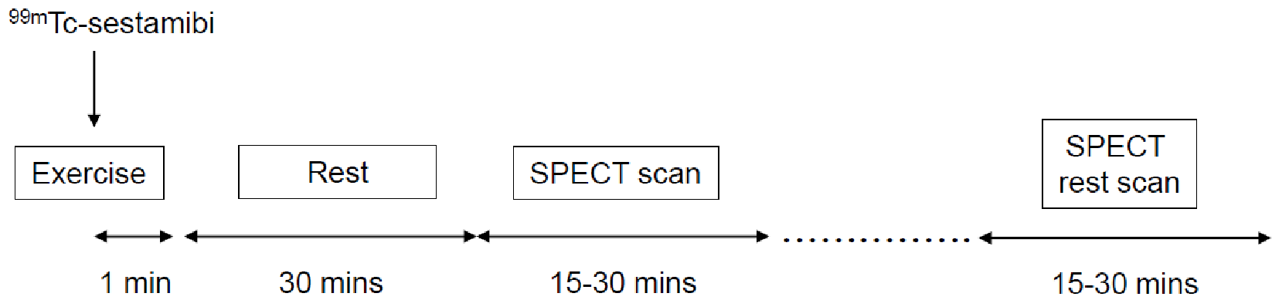
Myocardial Perfusion Imaging (MPI)
^{99m}Tc-sestamibi
Tracer uptake controlled by local blood flow
Exercise increases blood flow (3-5X higher), which increases dilation of normal arteries, but not diseased ones.

Slide 17

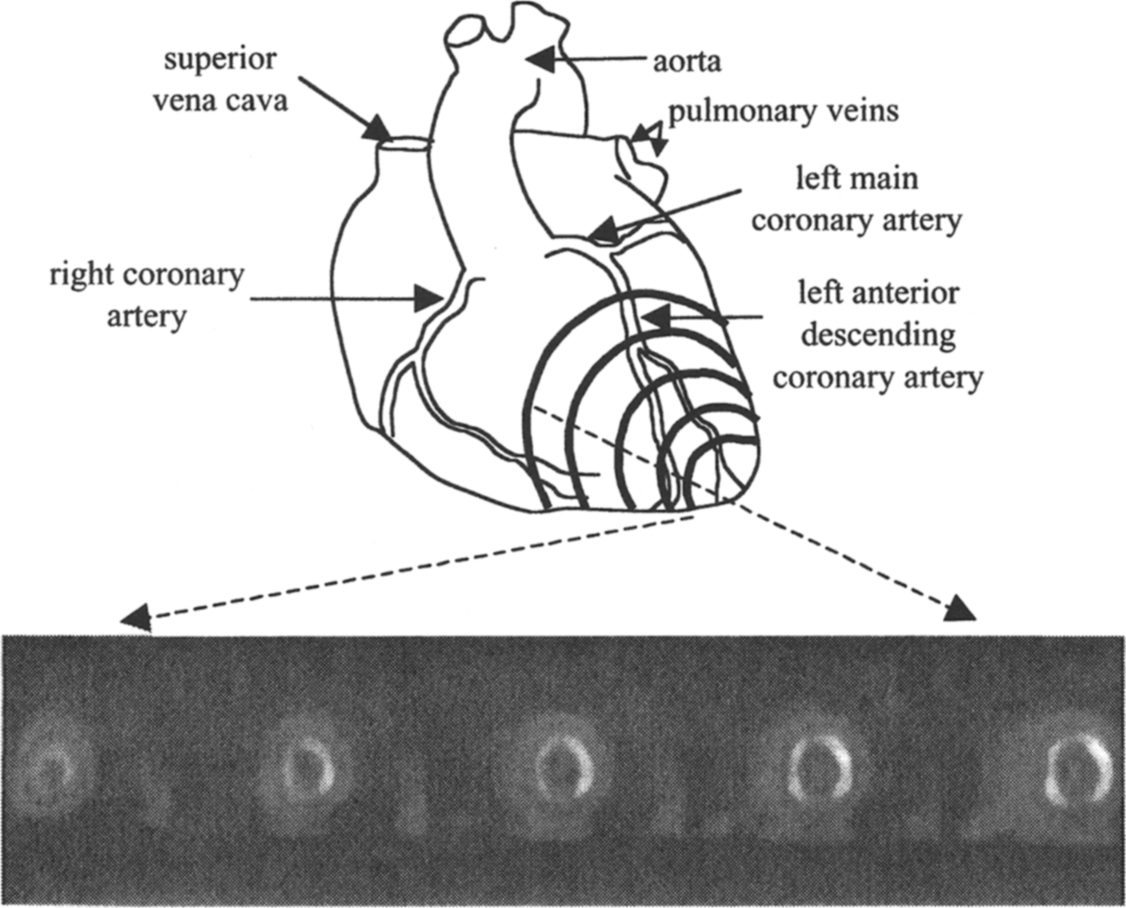
Myocardial Perfusion Imaging (MPI)

Slide 18
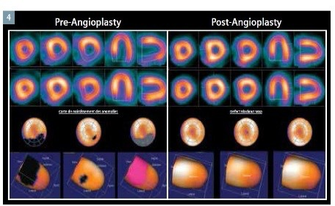
Myocardial Perfusion Imaging

Slide 19
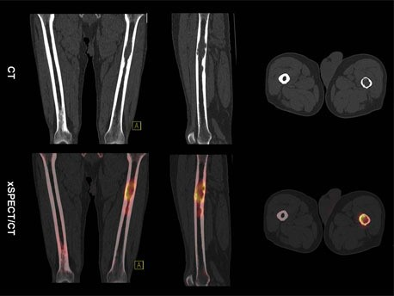
Bone and Oncology Imaging
^{99m}Tc-methyl diphosphonate (MDP)

Slide 20

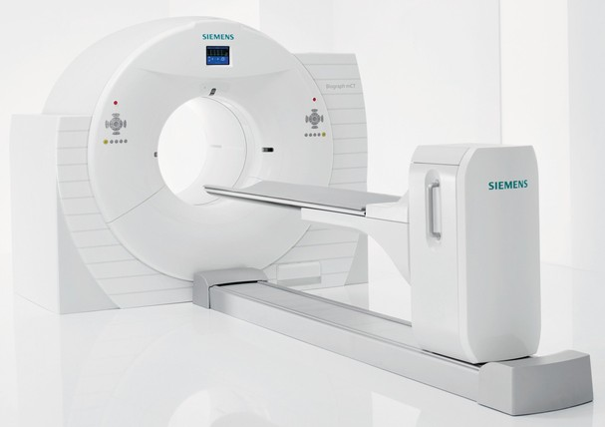
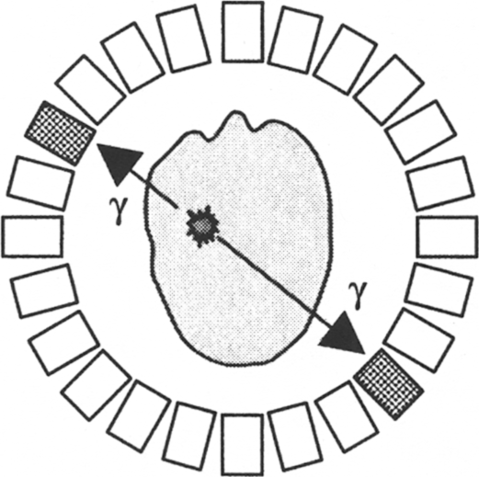
PET Overview
Positron (β⁺) emitting radiotracers are injected into the subject (Always positron emitter!)
The two back-to-back annihilation photons are detected simultaneously by separate detectors
Annihilation photon path is determined by position of the two involved detectors

Slide 21
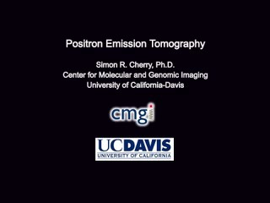
PET Overview

Slide 22
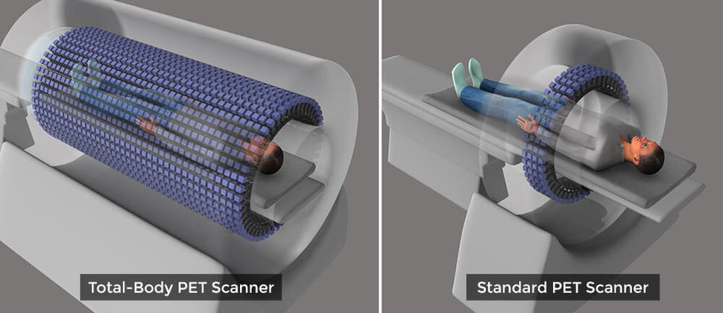
United Imaging Total Body PET

Slide 23
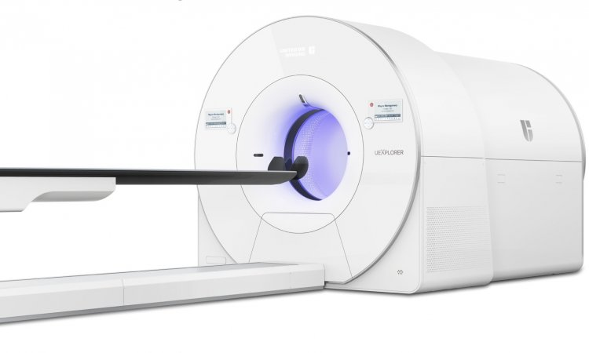
联影 uExplorer

Slide 24
The World‘s First Total-body PET-CT uEXPLORER
https://www.youtube.com/watch?v=qGElYRqP8SA

Slide 25
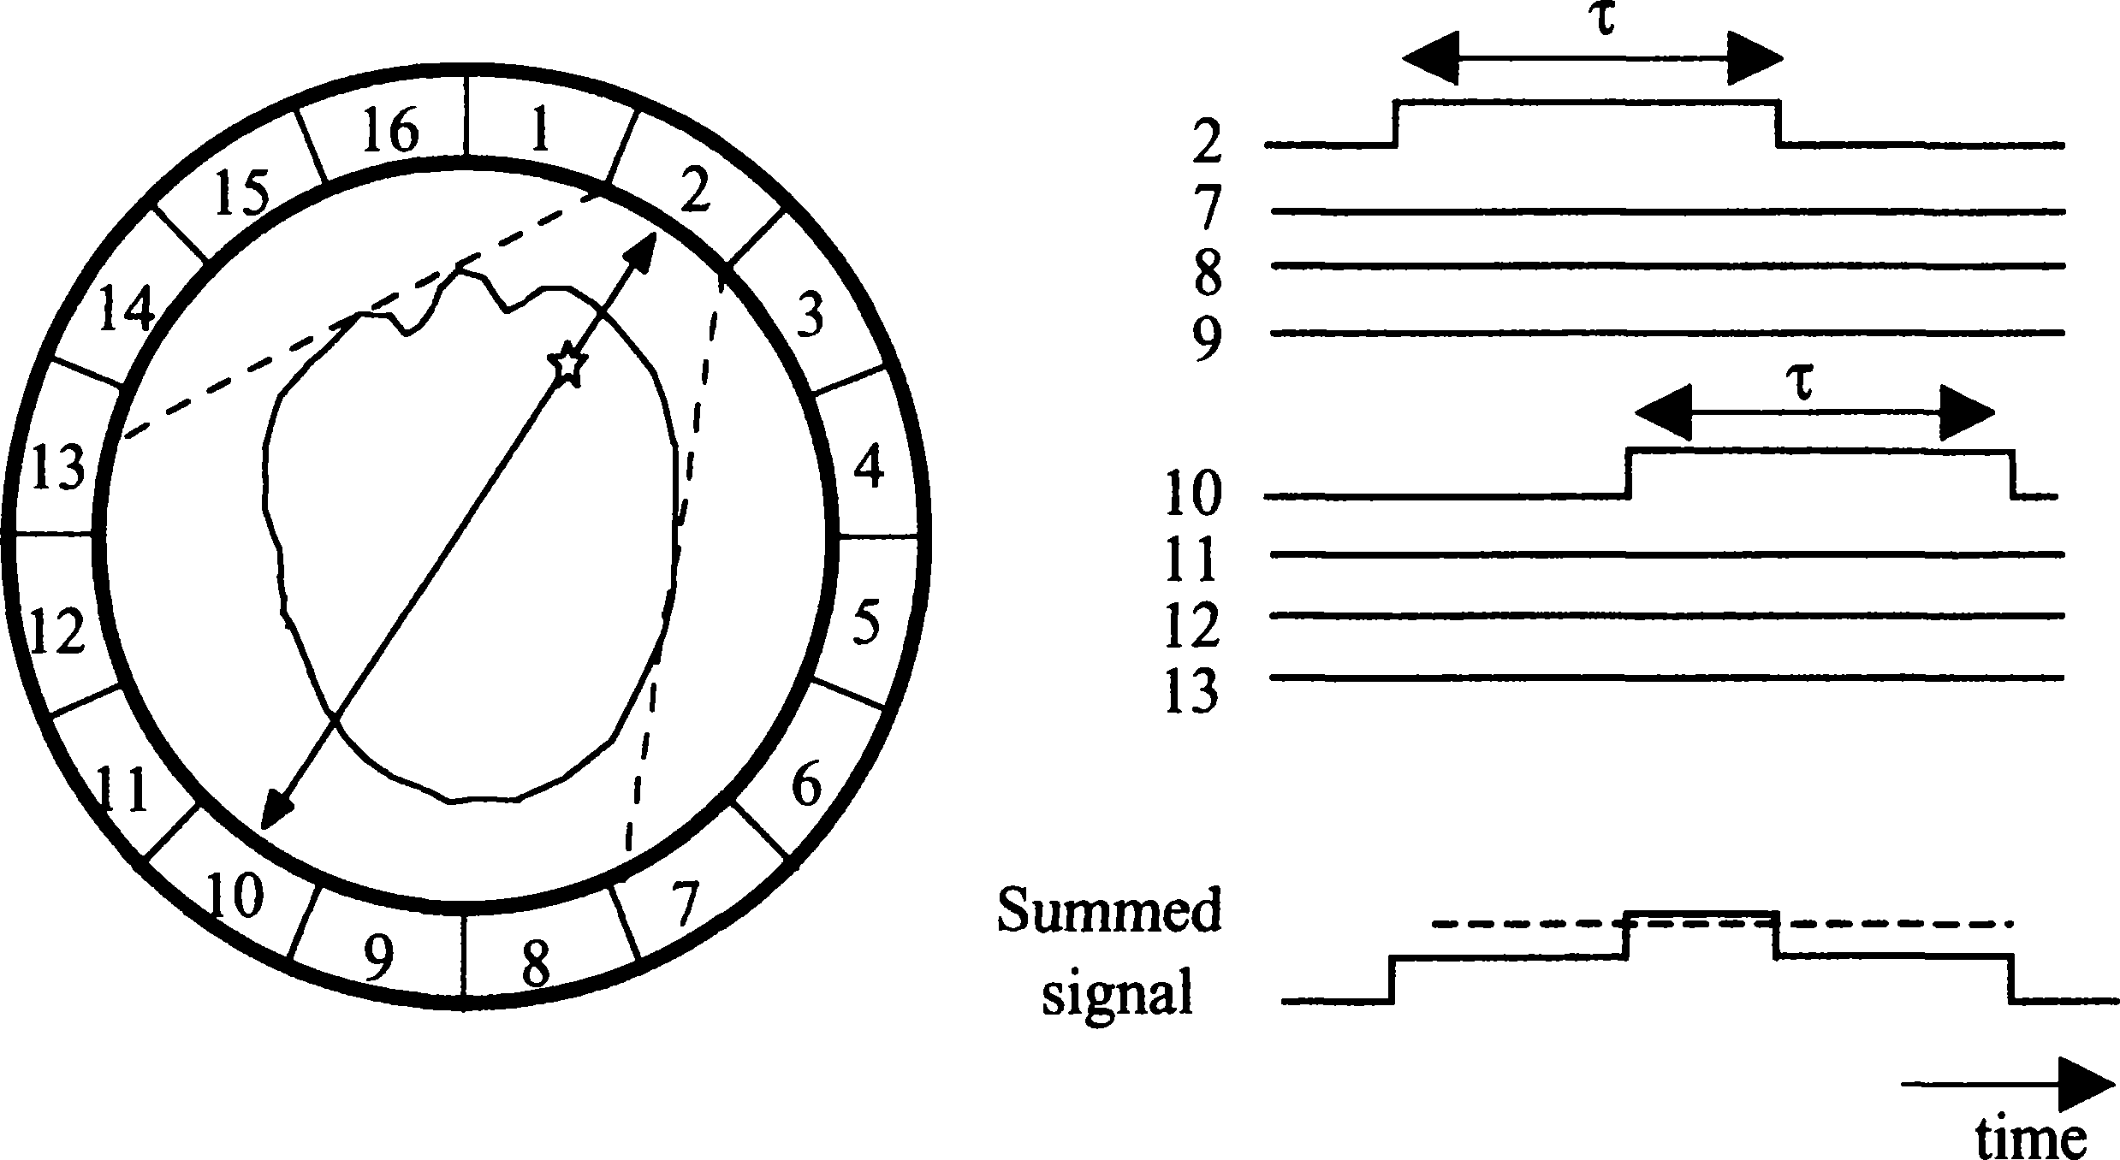
Annihilation Coincidence Detection (ACD)
Coincidence Timing Window (6-12 ns)
Detected Coincidence
Annihilation Photons

Slide 26
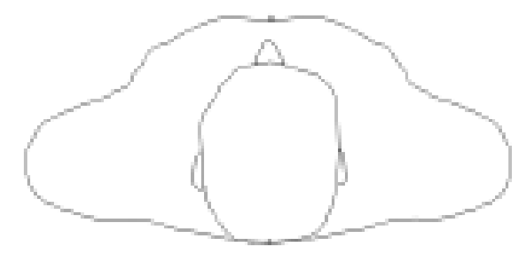


Annihilation Coincidence Detection
Detector
Annihilation Photons
Line of Response
ACD significantly restricts the volume that detectors are sensitive to annihilation photons
Only annihilation photons that originate at locations within the tube or line of response (LOR) can be detected
ACD is form of electronic collimation (vs. absorptive for SPECT)

Slide 27
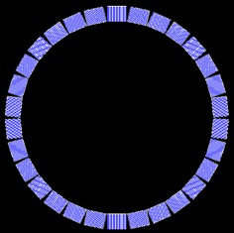
Coincidence Binning
0
1
2
3
Sinogram
LORs can be formed between many detector combinations
The location (index) of detectors involved in a coincidence detection determine the sinogram bin

Slide 28
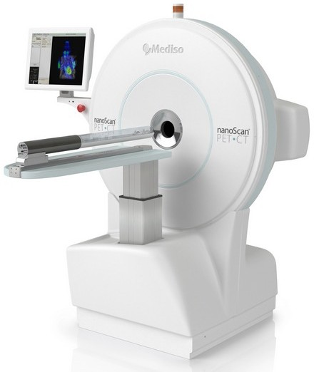
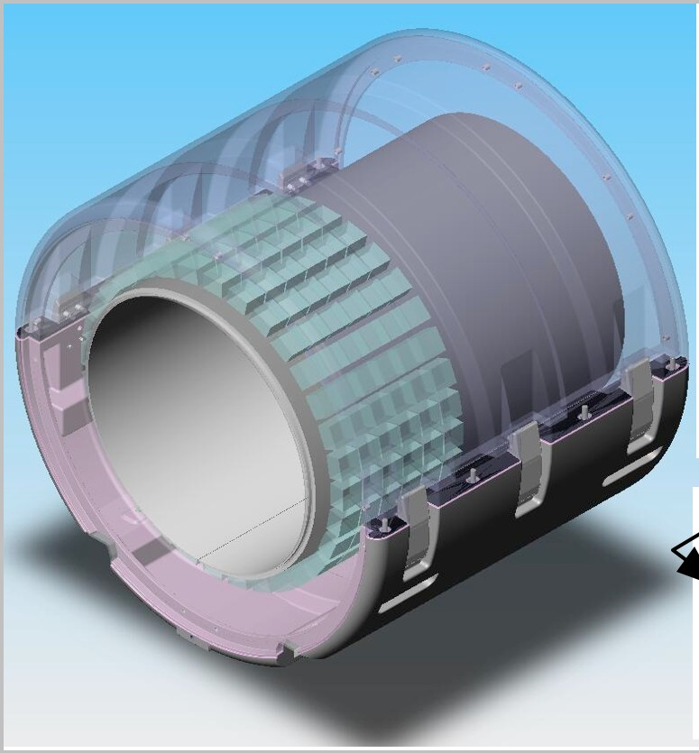
PET Scanners
Whole-Body Scanner
Small Animal Scanner
Dedicated Brain Scanner

Slide 29
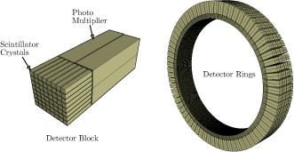
PET Detectors
Detector blocks are arranged into detector rings to maximize gamma-ray detection

Slide 30
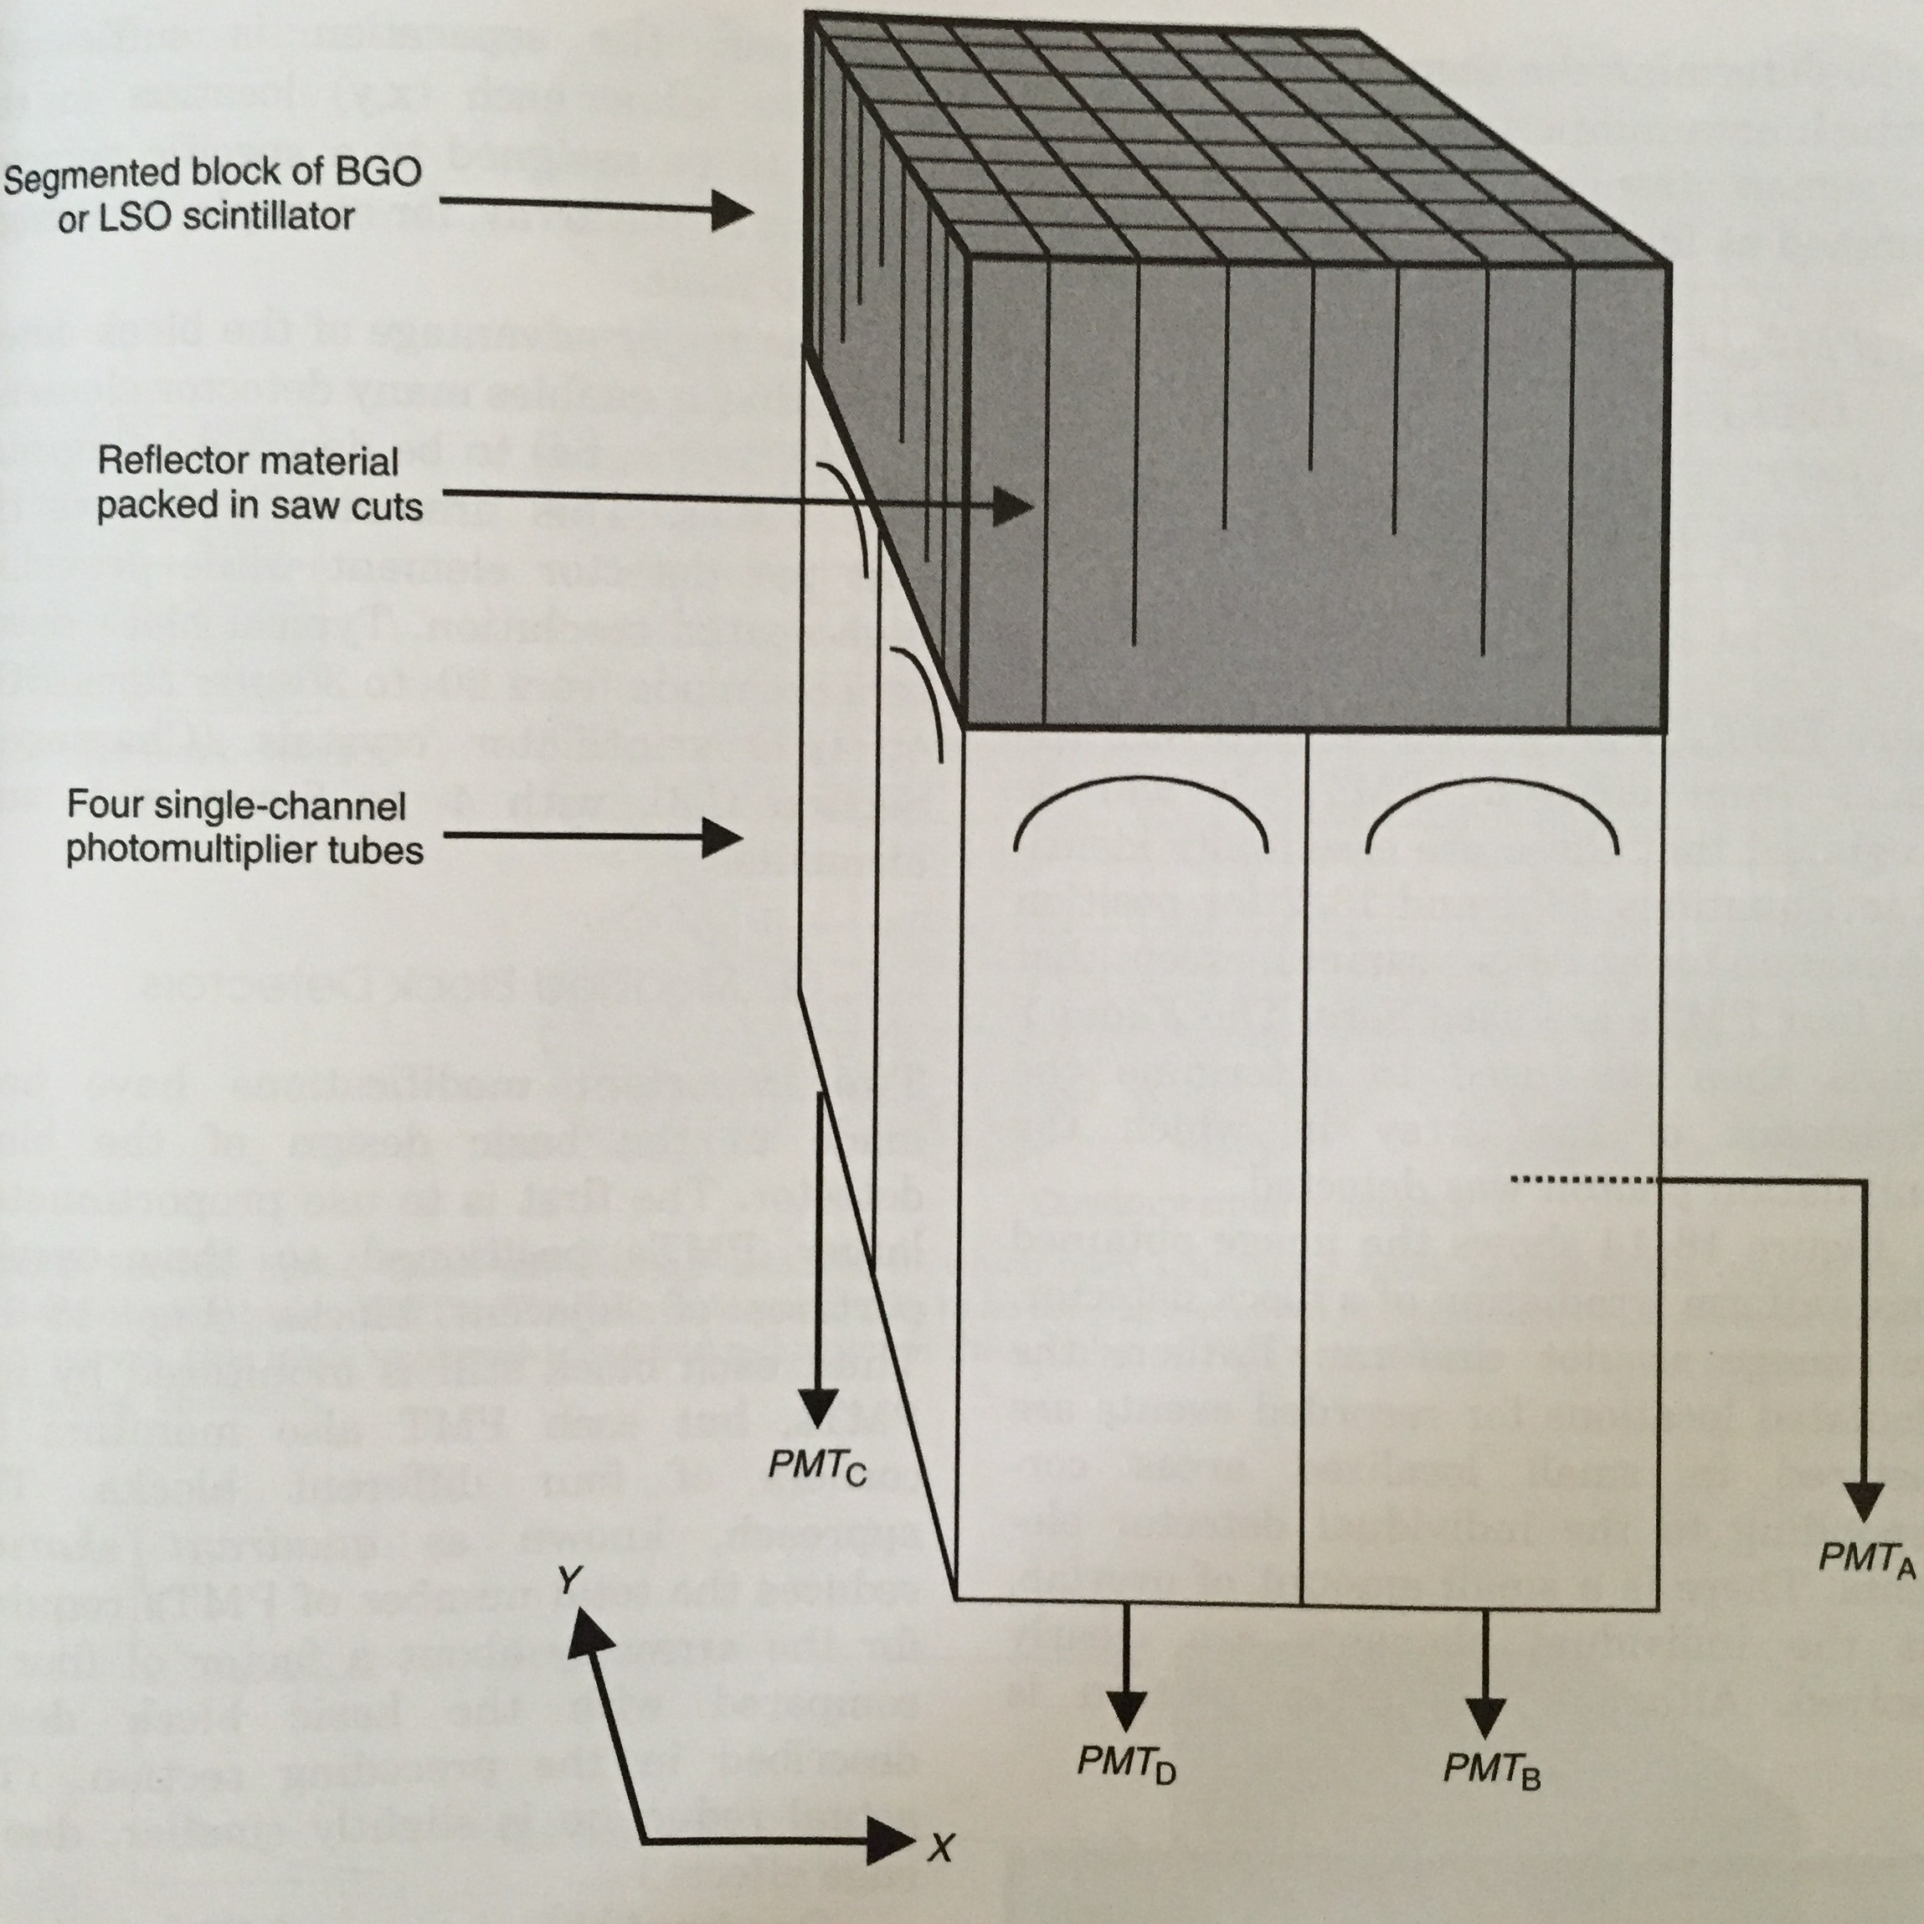
Block Detector
Blocks are partially segmented into long crystals (~2 cm)
Spread of scintillation light on PMTs dependent on interaction position
Four PMTs read out scintillation light and position events with Anger Logic

Slide 31
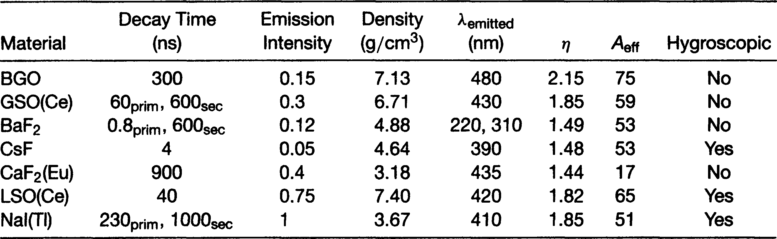
Scintillators
511 keV gamma-rays require scintillators to have high LACs to be absorbed
Timing resolution (ability separate events in time) is reflected in the decay time (lower decay time=improved resolution=smaller coincidence window)

Slide 32


Positron Decay + Migration
p⁺ → n + e⁺ + ν + energy
Nucleus
Positron
Positron Path
Effective Positron Range
511 keV photon
511 keV photon
Annihilation Reaction
Positrons will migrate and “bounce” off electrons before undergoing an annihilation reaction
Causes annihilation point to be different from radiotracer location!

Slide 33
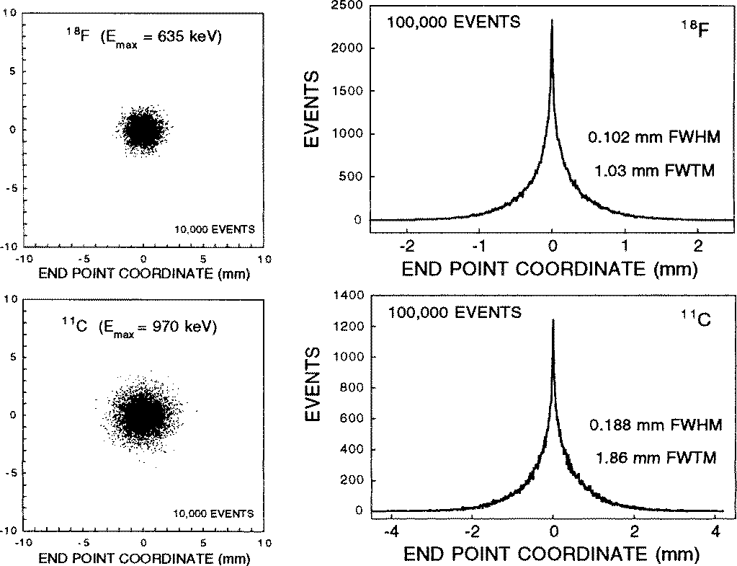
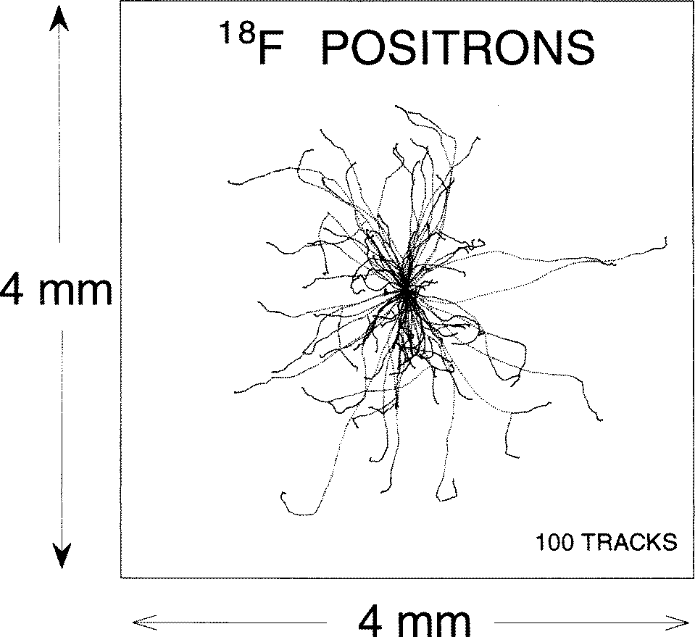
Effect of Positron Migration on Resolution
Positron range depends on emission energy of the positron and material of interaction (FWTM=1-4 mm)
Increasing β+ energy
Increase in β+ range Degradation in resolution

Slide 34
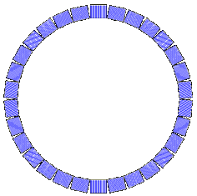
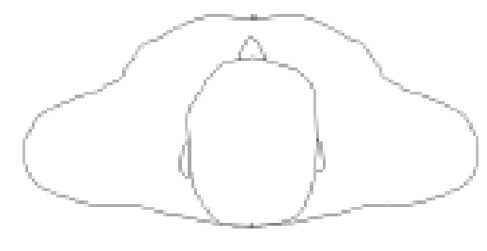

Photon Non-colinearity
Non-colinearity spatial resolution
R = 0.0022 ⋅ D
180
°
D
D= PET detector diameter
θ
Non-zero positron momentum during annihilation causes 511 keV photons not to be exactly back-to-back (θ≠180°)
Becomes worse as scanner diameter increases (~2 mm)

Slide 35
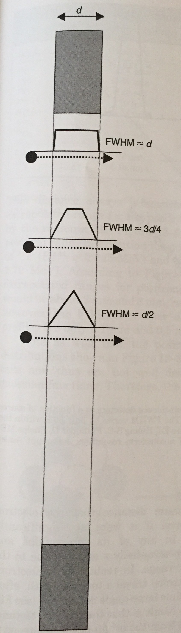
Detector Spatial Resolution
Depends primarily on the face dimensions of the pixelated scintillator elements
Increase face dimension
Degrades spatial resolution
Typically the dominant source of spatial resolution loss for PET scanners (~4 mm)

Slide 36


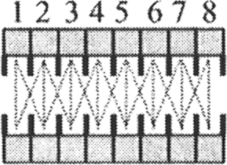
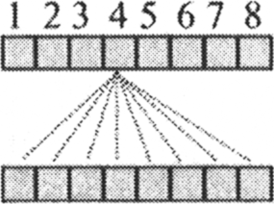
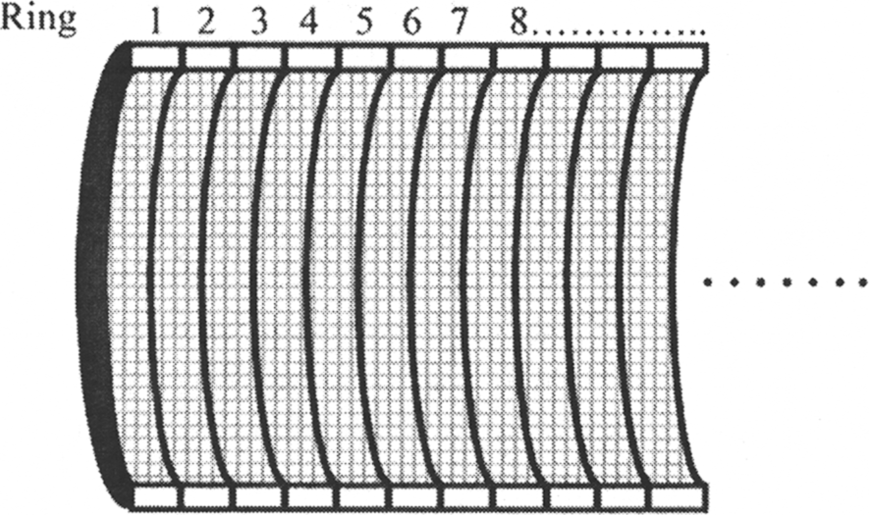
2D and 3D PET
Cross-Section View
2D
3D
2D PET restricts coincidences axially to direct and cross- planes
3D PET utilizes nearly all available axial detector combinations
3D PET has significantly higher photon efficiency than 2D PET (>=50% increase in reconstructed image SNR)

Slide 37
Image Reconstruction
Iterative reconstruction is primarily, as in SPECT, but reconstruction problem is different in PET
Subject Attenuation
Subject Compton Scatter
y ≈ Poisson(APx + s + r)
System Matrix
Randoms
Data
Activity
Distribution

Slide 38
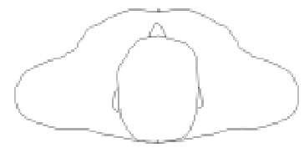
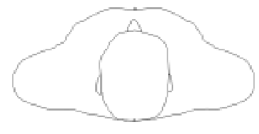

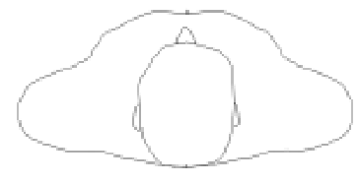

Coincidence Types
True
Random
Scatter
Scatter

Slide 39
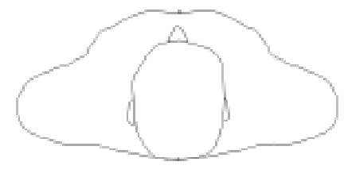


Randoms (Accidental Coincidences)
Definition: Coincidences that are formed between annihilation photons originating from separate emissions
C
A
= 2τ S S
j
ij i j
C^{A} = random coincidence rate
ij
τ
between detectors i and j
= coincidence window (sec)
i
S_{x} = singles rate on detector x (cps)
Randoms cause very low frequency positive bias to reconstructed uptake estimates if not corrected for
Rates of singles (detected γ-rays used to perform ACD) are increased with higher injected activity

Slide 40
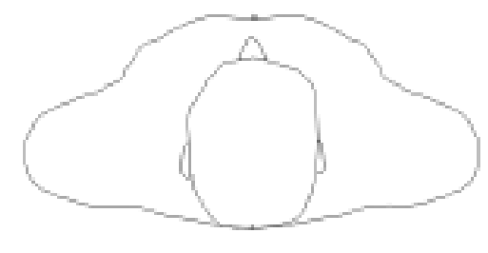
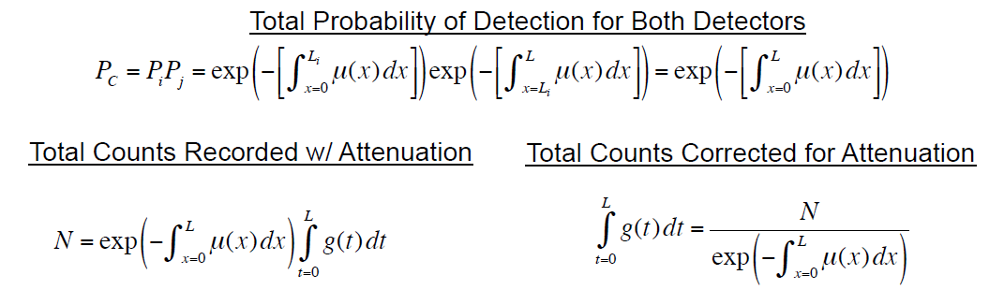
Attenuation Correction
Number of Counts
x=0
L
N
i
g(x
µ(x)
j
N
)
Line of Response
L_{i}
L_{j}
g(x) = annihilation events at x P_{x}
µ(x) = linear attenuation at x
= probability of photon detection

Slide 41
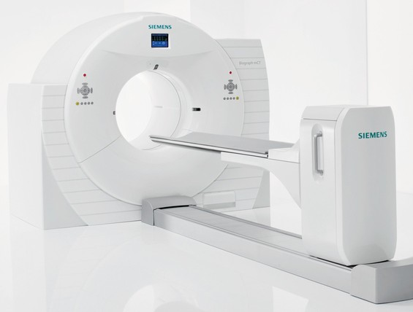
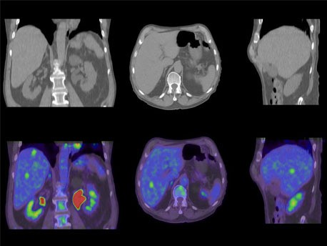
PET-CT
Subjects are scanned sequentially
Almost all PET systems sold today are combined with CT
Significantly improves tracer localization, fusion registration accuracy, and improves photon attenuation correction

Slide 42
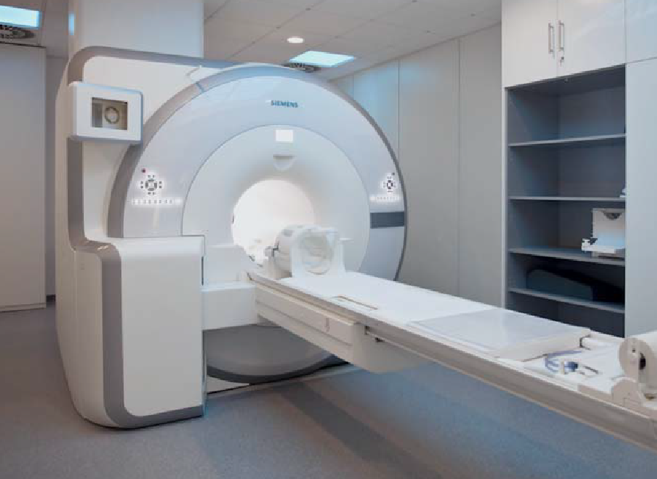



PET-MRI
PET-MRI Scanner
MRI
11A
PET
Fusion
11B
11C
cular
Modern systems image subjects simultaneously
Combines very high soft tissue diagnostic sensitivity of MRI with high specificity of PET
May have advantages in brain, cardiac, and focused oncology imaging compared with PET-CT

